Slide 1
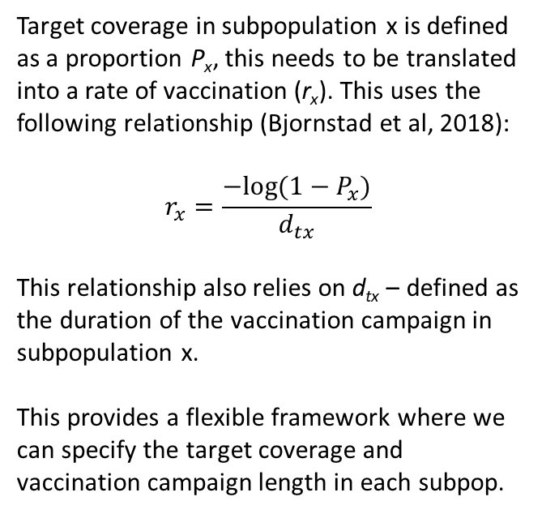
Parameter | Description
E_{ff} | Efficacy of Vaccination
r_{x} | Rate of Vaccination
β_{xy} | Per capita rate of transmission from infectious subpopulation y to susceptible subpopulation x
γ | Per capita rate of recovery
V_{i}
r_{i}·E_{ff}
S_{i}
β_{ii}
I_{i}
γ
R_{i}
Population i
β_{ji}
β_{ij}
V_{j}
r_{j}·E_{ff}
S_{j}
β_{jj}
I_{j}
γ
R_{j}
β_{ki}
Population j
β_{ik}
Target coverage in subpopulation x is defined as a proportion P_{x}, this needs to be translated into a rate of vaccination (r_{x}). This uses the following relationship (Bjornstad et al, 2018):
$$r_{x}=\frac{−log⁡(1−P_{x})}{d_{tx}}$$
This relationship also relies on d_{tx} – defined as the duration of the vaccination campaign in subpopulation x.
This provides a flexible framework where we can specify the target coverage and vaccination campaign length in each subpop.
β_{kj}
β_{jk}
V_{k}
r_{k}·E_{ff}
S_{k}
β_{kk}
I_{k}
γ
R_{k}
Population k
We assume that vaccination will only take place in those who are susceptible and will permanently move them to compartment V.

Slide 2
Reduced transmission when vaccinated
Probability of getting infected when vaccinated
Iv_{i}
(1-e_{ff2})(β_{ii} + …+ β_{xx})
(1-e_{ff1})(β_{ii} + …+ β_{xx})
γ
V_{i}
r_{i}
S_{i}
β_{ii}
I_{i}
γ
R_{i}
Population i
φ
φ
Infecting Population I
(3 subpops i, j and k)
(β_{ii})(I_{i})(S_{i})
(β_{ij})(I_{j})(S_{i})
(β_{ik})(I_{k})(S_{i})
(1-e_{ff2})(β_{ii})(Vi_{i})(S_{i})
(1-e_{ff2})(β_{ij})(Vi_{j})(S_{i})
(1-e_{ff2})(β_{ik})(Vi_{k})(S_{i})
Subpopulation I infecting other subpopulations
(3 subpops i, j and k)
(1-e_{ff1})(β_{ii})(I_{i})(S_{i})
(1-e_{ff1})(β_{ij})(I_{j})(S_{i})
(1-e_{ff1})(β_{ik})(I_{k})(S_{i})
(1-e_{ff1})(1-e_{ff2})(β_{ii})(Vi_{i})(S_{i})
(1-e_{ff1})(1-e_{ff2})(β_{ij})(Vi_{j})(S_{i})
(1-e_{ff1})(1-e_{ff2})(β_{ik})(Vi_{k})(S_{i})

Slide 3
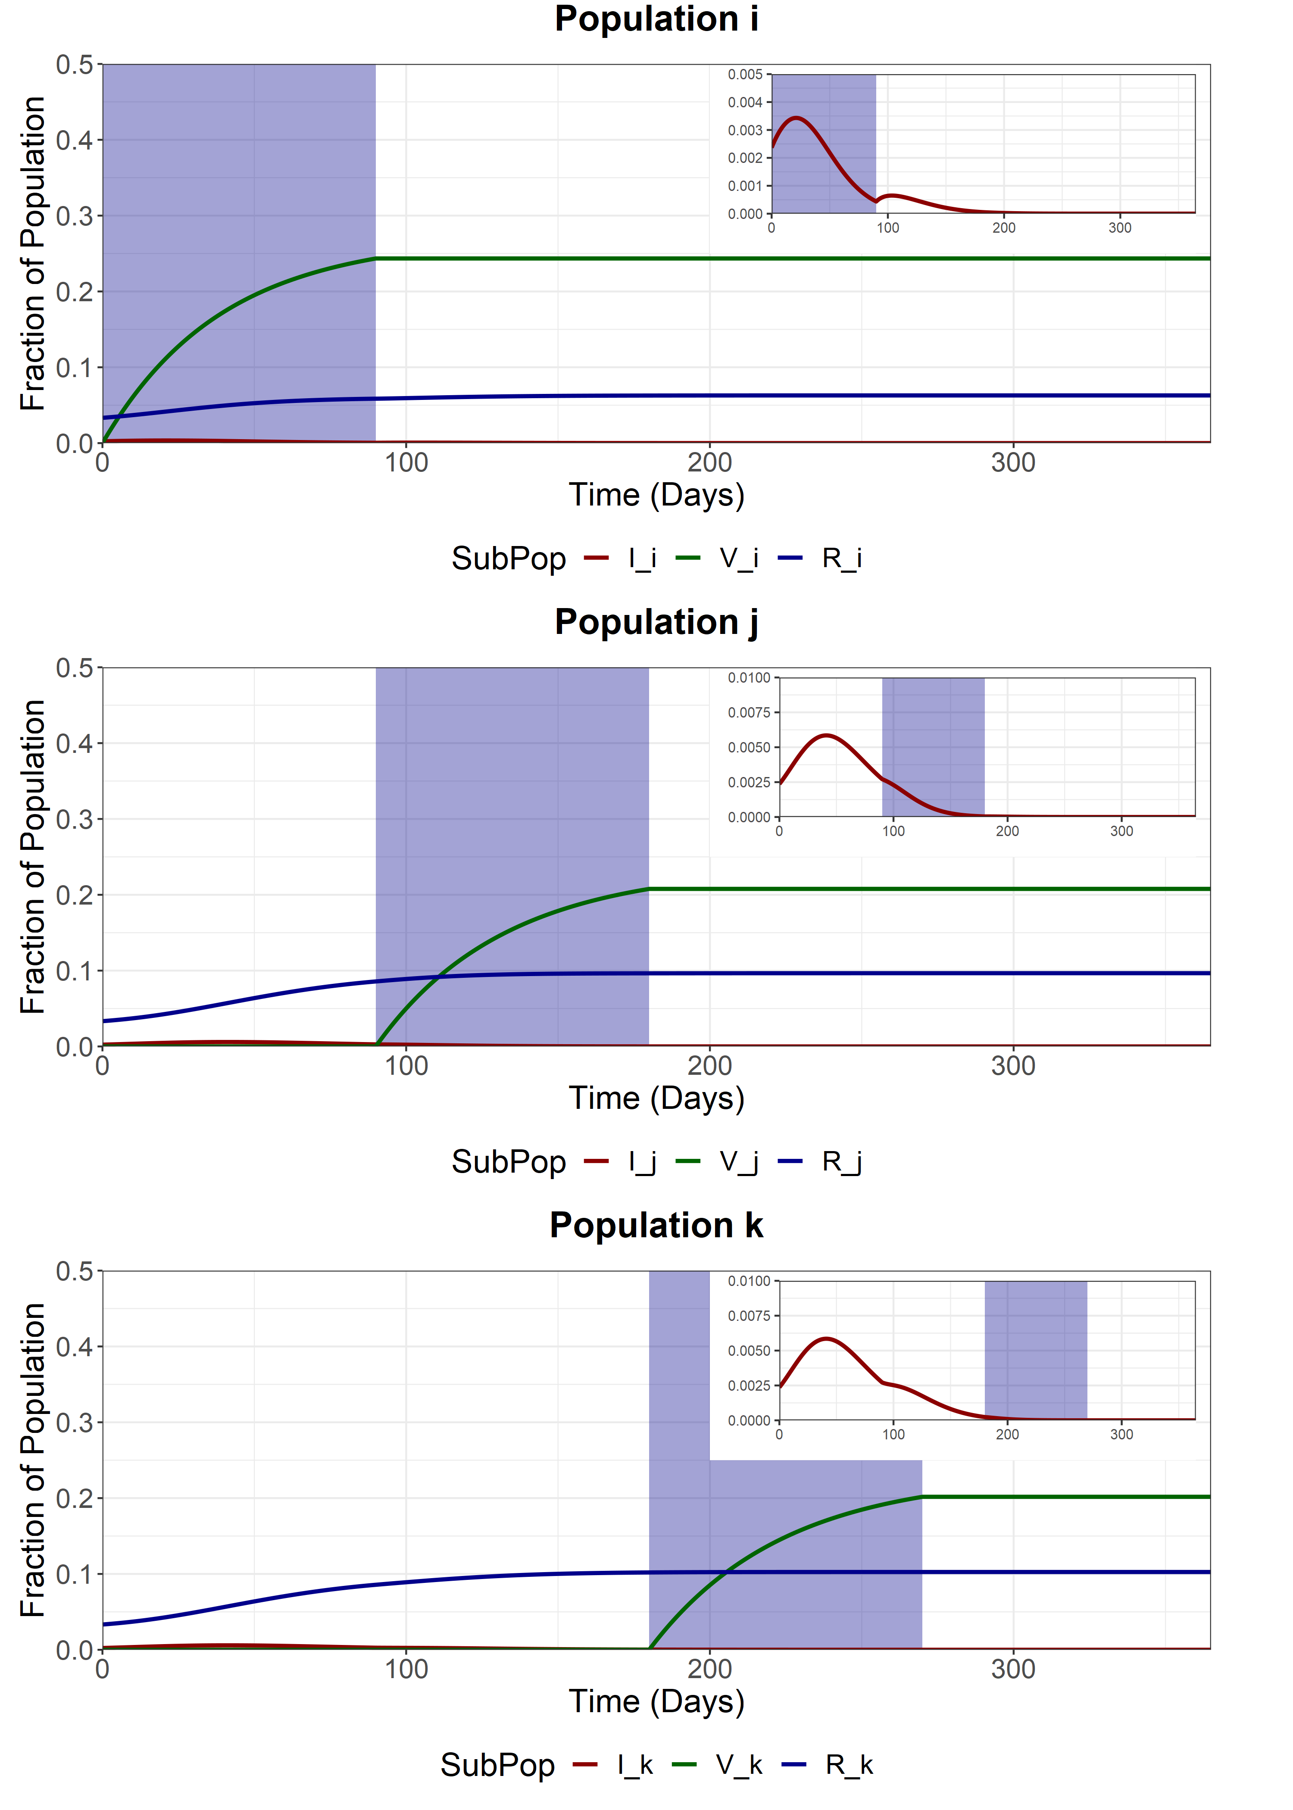
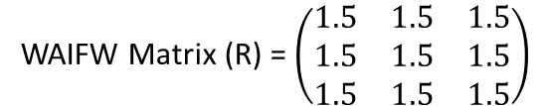
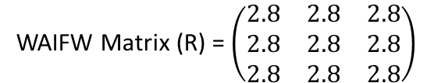
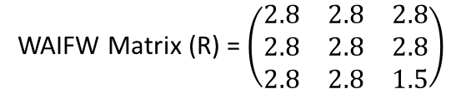
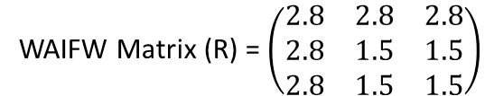
Scenario
We model sequential vaccination of 3 sub-populations. Each vaccination schedule lasts 90 days and aims for 90% coverage of the available susceptibles at the beginning of the simulation.
After vaccination of each subpopulation, the sub-population is released from NPIs, with the R increasing from 1.5 to 2.8.
We assume that 0.71% of the Scottish population is currently infected and 10% have already been infected and are now “Recovered”. Each subpopulation is proportionately the same size.
Vaccine efficacy is modelled at 90%.
Subpopulation i
Target Coverage = 90%
Duration = 90 days
Trigger Date = day 0
Subpopulation j
Target Coverage = 90%
Duration = 90 days
Trigger Date = day 90
Subpopulation k
Target Coverage = 90%
Duration = 90 days
Trigger Date = day 180
Initial Conditions
S_{i} = 0.297633
S_{j} = 0.297633
S_{k} = 0.297633
I_{i} = 0.0071/3
I_{j} = 0.0071/3
I_{k} = 0.0071/3
V_{i} = 0
V_{j} = 0
V_{k} = 0
R_{i} = 0.1/3
R_{j} = 0.1/3
R_{k} = 0.1/3
WAIFW Matrix (R) = $\left(\begin{matrix}1.5 & 1.5 & 1.5 \\ 1.5 & 1.5 & 1.5 \\ 1.5 & 1.5 & 1.5\end{matrix}\right)$
During the pop i vaccination (t = 0-90)
WAIFW Matrix (R) = $\left(\begin{matrix}2.8 & 2.8 & 2.8 \\ 2.8 & 1.5 & 1.5 \\ 2.8 & 1.5 & 1.5\end{matrix}\right)$
During the pop j vaccination (t = 90-180)
In subpopulation k, we can observe a “knock-on” effect when interventions are released in other sub populations.
Note the little bumps in prevalence.
WAIFW Matrix (R) = $\left(\begin{matrix}2.8 & 2.8 & 2.8 \\ 2.8 & 2.8 & 2.8 \\ 2.8 & 2.8 & 1.5\end{matrix}\right)$
During the pop k vaccination (t = 180-270)
WAIFW Matrix (R) = $\left(\begin{matrix}2.8 & 2.8 & 2.8 \\ 2.8 & 2.8 & 2.8 \\ 2.8 & 2.8 & 2.8\end{matrix}\right)$
After final vaccination schedule (t = 180-270)

Slide 4
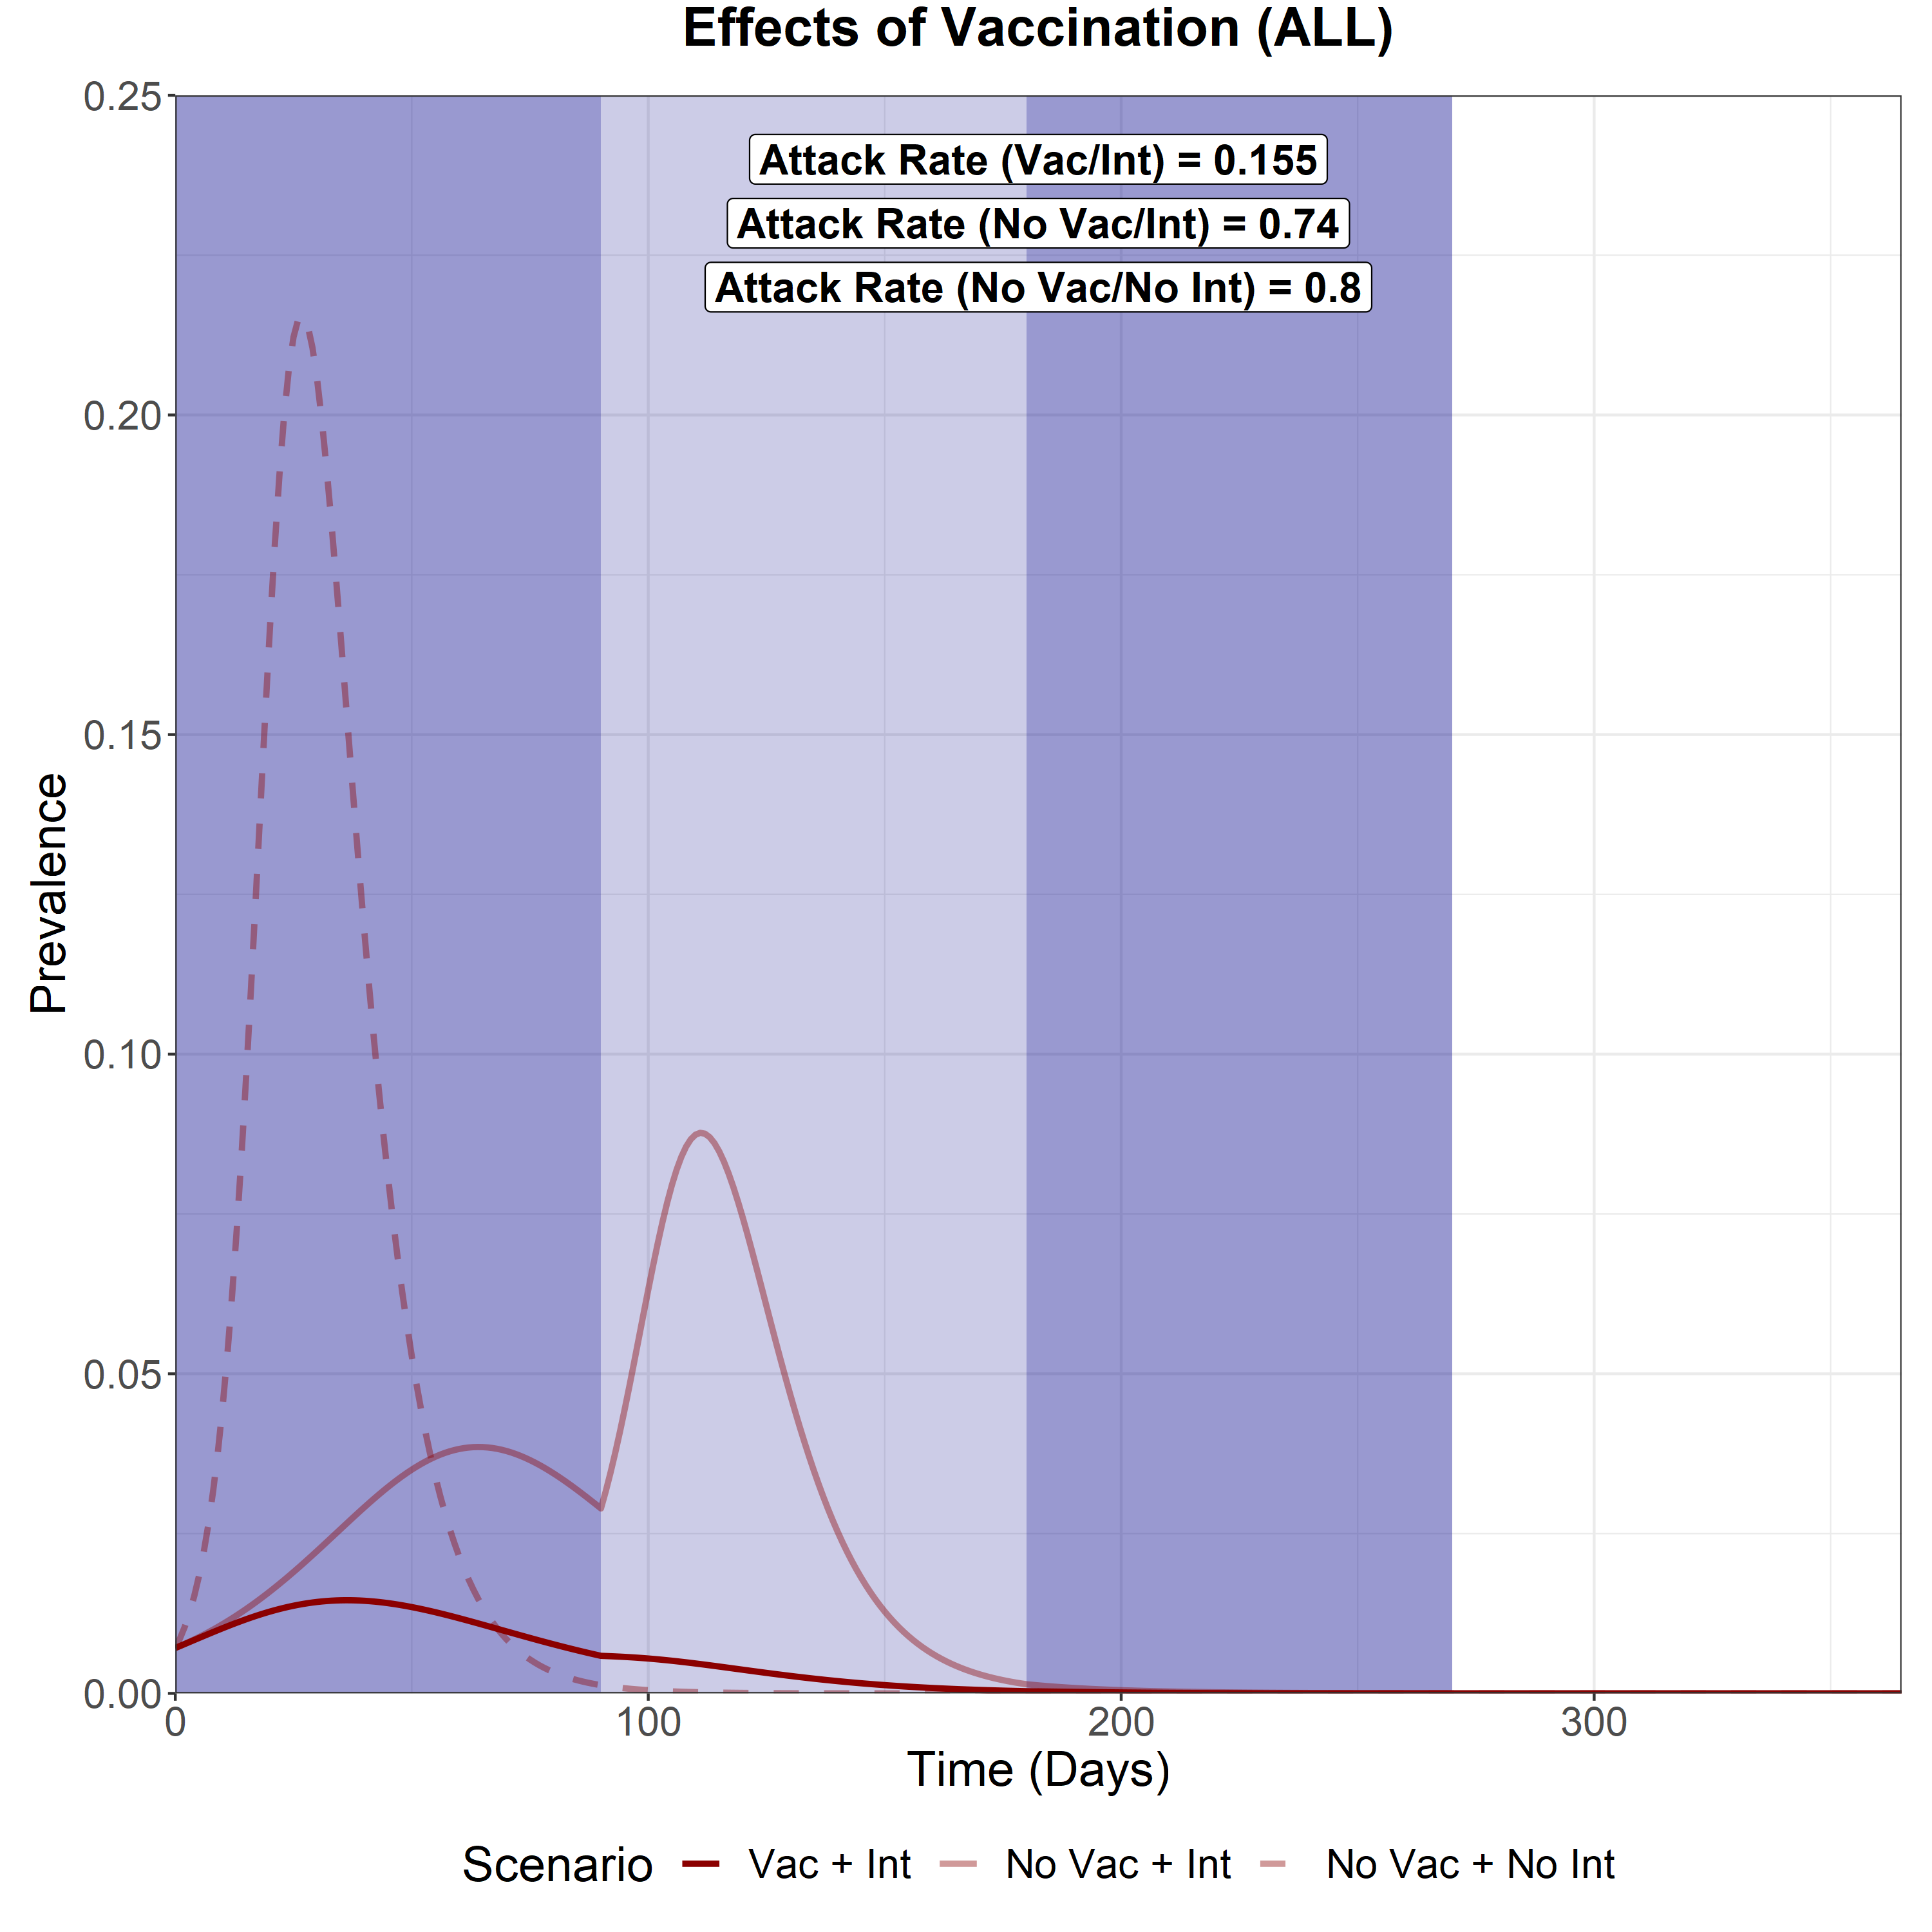
Scenario Analysis (Total)
We now compare the total epidemic curve (the sum of the infectious compartment in each subpopulation) for 3 different scenarios:
With vaccination and sequential intervention release
No vaccination but with sequential intervention release
No vaccination and no interventions
The three shaded areas are the vaccination periods for subpopulation i, j and k respectively.
We can see that by far the greatest impact on reducing the attack rate (cumulative prevalence over the simulated model, t = 365 days) is through the use of sequential vaccination.

